Slide 1
Consumer Surplus and Producer Surplus

Slide 2
Consumer Surplus and the Demand Curve
The market for used textbooks, concentrating on the buyers will be used to explain consumers surplus.
The example is going to show that the demand curve is derived from people’s tastes or preferences and these tastes and preferences also determine how much they gain from the opportunity to buy used books.

Slide 3
Consumer Surplus
Consumer surplus is an economic measurement of consumer benefits.
Consumer surplus happens when the price that consumers pay for a product or service is less than the price they're willing to pay.
It's a measure of the additional benefit that consumers receive because they're paying less for something than what they were willing to pay.

Slide 4
Willingness to Pay
Maximum price at which he or she would buy a good
Individuals won’t buy the good if it costs more than this among but eager to do so if it cost less
If the price is just equal to an individual’s willingness to pay, he or she is indifferent between buying and not buying

Slide 5
The Demand Curve for Used Textbooks
Price of book
$59
Aleisha
Potential buyers
Willingness to pay
Aleisha
$59
45
Brad
Brad
45
Claudia
35
35
Claudia
Darren
25
Edwina
10
25
Darren
A consumer’s willingness to pay for a good is the maximum price at which he or she would buy that good.
10
Edwina
D
0
1
2
3
4
5
Quantity of books
Notes:
Figure Caption:
Figure 4-1: The Demand Curve for Used Textbooks
With only five potential consumers in this market, the demand curve is step-shaped. Each step represents one consumer, and its height indicates that consumer’s willingness to pay—the maximum price at which each will buy a used textbook—as indicated in the table. Aleisha has the highest willingness to pay at $59, Brad has the next highest at $45, and so on down to Edwina with the lowest willingness to pay at $10. At a price of $59, the quantity demanded is one (Aleisha); at a price of $45, the quantity demanded is two (Aleisha and Brad); and so on until you reach a price of $10, at which all five students are willing to purchase a book.

Slide 6
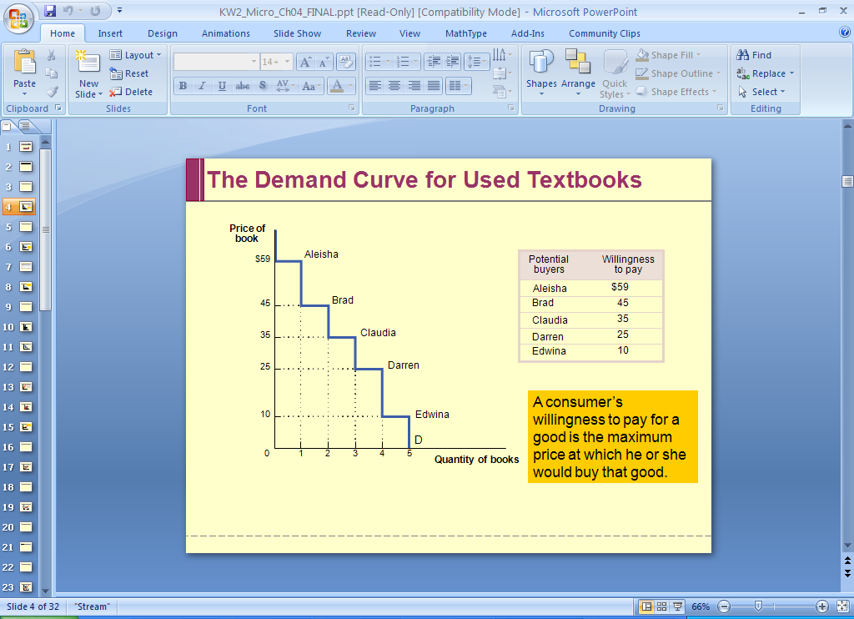
Willingness to Pay
Not a smooth curve because it is only dealing with a small number of consumers
Each horizontal segment = how much one is willing to pay
What is the quantity demanded at $59?
What is the quantity demanded at $45?

Slide 7
Willingness to Pay & Consumer Surplus
Campus Bookstore makes used textbooks available at a price of $30. Who will buy books?
Do they gain from their purchase?

Slide 8
Consumer Surplus in the Used Textbook Market
Price of book
The total consumer surplus is given by the entire shaded area - the sum of the individual consumer surpluses of Aleisha, Brad, and Claudia - equal to $29 + $15 + $5 = $49.
Aleisha’s consumer surplus:
$59-$30=$29
$59
Aleisha
Brad’s consumer surplus:
$45-$30=$15
45
Brad
Claudia’s consumer surplus: $35-$30=$5
35
Claudia
30
Price = $30
25
Darren
10
Edwina
D
0
1
2
3
4
5
Quantity of books
Notes:
Figure Caption:
Figure 4-2: Consumer Surplus in the Used-Textbook Market
At a price of $30, Aleisha, Brad, and Claudia each buy a book but Darren and Edwina do not. Aleisha, Brad, and Claudia get individual consumer surpluses equal to the difference between their willingness to pay and the price, illustrated by the areas of the shaded rectangles. Both Darren and Edwina have a willingness to pay less than $30, so they are unwilling to buy a book in this market; they receive zero consumer surplus. The total consumer surplus is given by the entire shaded area—the sum of the individual consumer surpluses of Aleisha, Brad, and Claudia—equal to $29 + $15 + $5 = $49.

Slide 9
Willingness to Pay & Consumer Surplus
Individual Consumer Surplus – net gain that a buyer achieves from the purchase of a good
  Whenever a buyer pays a price less than his or her willingness to pay, the buy achieves an individual consumer surplus
Total Consumer Surplus – sum of the individual consumer surpluses achieved by all the buyers of a good
  Aleisha, Brad and Claudia: $29 +$15 +$5 = $49

Slide 10
Changing Prices Affects Consumer Surplus
Textbook Example again…..
BUT……the bookstore has now decided to sell used textbooks for $20 instead of $30. How much would this fall in price increase consumer surplus?

Slide 11
Consumer Surplus and a Fall in the Price of Used Textbooks
Price of book
Increase in Aleisha’s consumer surplus
$59
Aleisha
Increase in Brad’s consumer surplus
45
Brad
Increase in Claude’s consumer surplus
35
Claudia
30
Original price = $30
25
Darren
20
New price = $20
Darren’s consumer surplus
10
Edwina
D
0
1
2
3
4
5
Quantity of books
Notes:
Figure Caption:
Figure 4-4: Consumer Surplus and a Fall in the Price of Used Textbooks
There are two parts to the increase in consumer surplus generated by a fall in price from $30 to $20. The first is given by the dark blue rectangle: each person who would have bought at the original price of $30—Aleisha, Brad, and Claudia—receives an increase in consumer surplus equal to the total reduction in price, $10. So the area of the dark blue rectangle corresponds to an amount equal to 3 ×$10 =$30. The second part is given by the light blue area: the increase in consumer surplus for those who would not have bought at the original price of $30 but who buy at the new price of $20—namely, Darren. Darren’s willingness to pay is $25, so he now receives consumer surplus of $5. The total increase in consumer surplus is 3 ×$10 +$5 =$35, represented by the sum of the shaded areas. Likewise, a rise in price from $20 to $30 would decrease consumer surplus by an amount equal to the sum of the shaded areas.

Slide 12
Changing Prices Affects Consumer Surplus
The graph showed that when the price of a good falls, the area under the demand curve but not above the price (which is equal to total consumer surplus) increases

Slide 13
Producer Surplus and the Supply Curve
We have buyers of goods that would be willing to pay more for their purchase than the price they actually pay
Some sellers of a good would have been willing to sell it for less than the price they actually receive.

Slide 14
Producer Surplus
Producer surplus is the amount that the producer benefits from selling above the price they would otherwise be willing to sell for.
The producer surplus can be calculated by taking total revenue and subtracting total cost.
Producer surplus and consumer surplus both amount to the total benefit to society – otherwise known as the economic surplus.

Slide 15
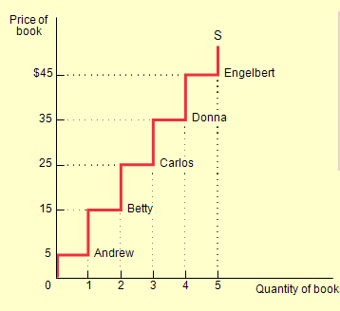
Producer Surplus and the Supply Curve
Seller’s cost – lowest price at which a potential seller is willing to sell
What is Andrew’s cost? What is Betty’s cost?

Slide 16
Producer Surplus and the Supply Curve
Since the students don’t have to manufacture the books, does it cost the student who sells a book anything to make that book available for sale?
YES!
You won’t have it later in your personal collection – opportunity cost!
When saying “cost” of a good as a seller, referring to selling that good even if you don’t spend any money to sell the good

Slide 17
Producer Surplus and the Supply Curve
Individual Producer Surplus – the net gain, the difference between the price he actually gets and his cost, the minimum price at which he would have been willing to sell
Total Producer Surplus – the total net gain to all sellers in the market
Producer Surplus – refers to either the total or individual producer surplus

Slide 18
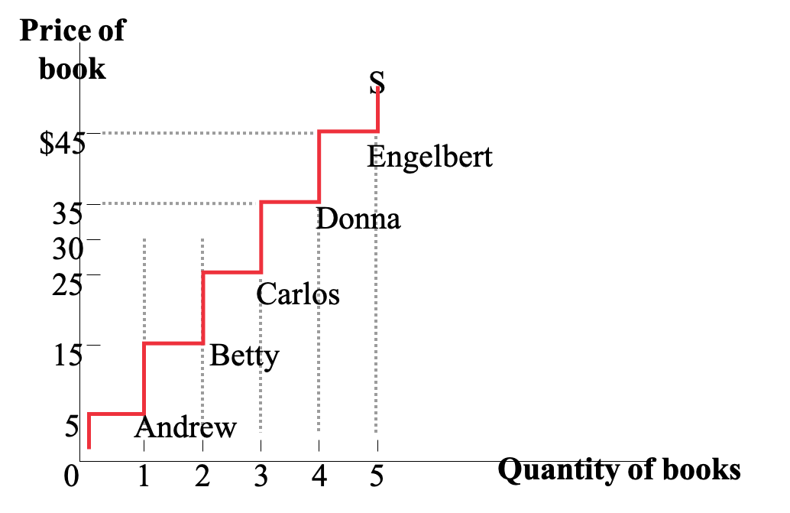
Producer Surplus in the Used Textbook Market
Total Producer Surplus is given by the entire shaded area,
the sum of the individual producer surpluses of Andrew,
Betty, and Carlos.
$25 + $15 + $5 = $45
Price = $30
Carlos’s producer surplus
Betty’s producer surplus
Andrew’s producer surplus
The total producer surplus from sales of a good at a given price
is the area above the supply curve but below that price.
Notes:
Figure Caption:
Figure 4-7: Producer Surplus in the Used-Textbook Market
At a price of $30, Andrew, Betty, and Carlos each sell a book but Donna and Engelbert do not. Andrew, Betty, and Carlos get individual producer surpluses equal to the difference between the price and their cost, illustrated here by the shaded rectangles. Donna and Engelbert each have a cost that is greater than the price of $30, so they are unwilling to sell a book and so receive zero producer surplus. The total producer surplus is given by the entire shaded area, the sum of the individual producer surpluses of Andrew, Betty, and Carlos, equal to $25 +$15 +$5 =$45.

Slide 19
How Changing Price Affects Producer Surplus?
When the price of a good rises, producer surplus increases through two ways:
The gains of those who would have supplied the good even at the original, lower price and
The gains of those who are induced to supply the good by the higher price.

Slide 20


A Rise in the Price Increases Producer Surplus
Increase in producer surplus to original sellers
Producer surplus gained by new sellers
S
Notes:
Figure Caption:
Figure 4-9: A Rise in the Price Increases Producer Surplus
A rise in the price of wheat from $5 to $7 leads to an increase in the quantity supplied and an increase in producer surplus. The change in total producer surplus is given by the sum of the shaded areas: the total area above the supply curve but between the old and new prices. The dark red area represents the gain to the farmers who would have supplied 1 million bushels at the original price of $5; they each receive an increase in producer surplus of $2 for each of those bushels. The triangular light red area represents the increase in producer surplus achieved by the farmers who supply the additional 500,000 bushels because of the higher price. Similarly, a fall in the price of wheat generates a reduction in producer surplus equal to the sum of the shaded areas.

Slide 21
Consumer Surplus, Producer Surplus, and the Gains from Trade
Total Surplus generated in a market is the total net gain to consumers and producers from trading in the market. It is the sum of the producer and the consumer surplus
This also shows there are gains from trade

Slide 22




Total Surplus
S
Consumer surplus
Equilibrium price
E
Producer surplus
D
Equilibrium quantity
Notes:
Figure Caption:
Figure 4-10: Total Surplus
In the market for used textbooks, the equilibrium price is $30 and the equilibrium quantity is 1,000 books. Consumer surplus is given by the blue area, the area below the demand curve but above the price. Producer surplus is given by the red area, the area above the supply curve but below the price. The sum of the blue and the red areas is total surplus, the total benefit to society from the production and consumption of the good.

